Slide 1

Arsenic Skin Detection Using Machine Learning
CSE 499A: Project Proposal
Amit Chandra Das (2014242042), Tanushree Das (2212225042), Ashraful Islam (2212669042)
Section:15
Gorup:07
North South University

Slide 2
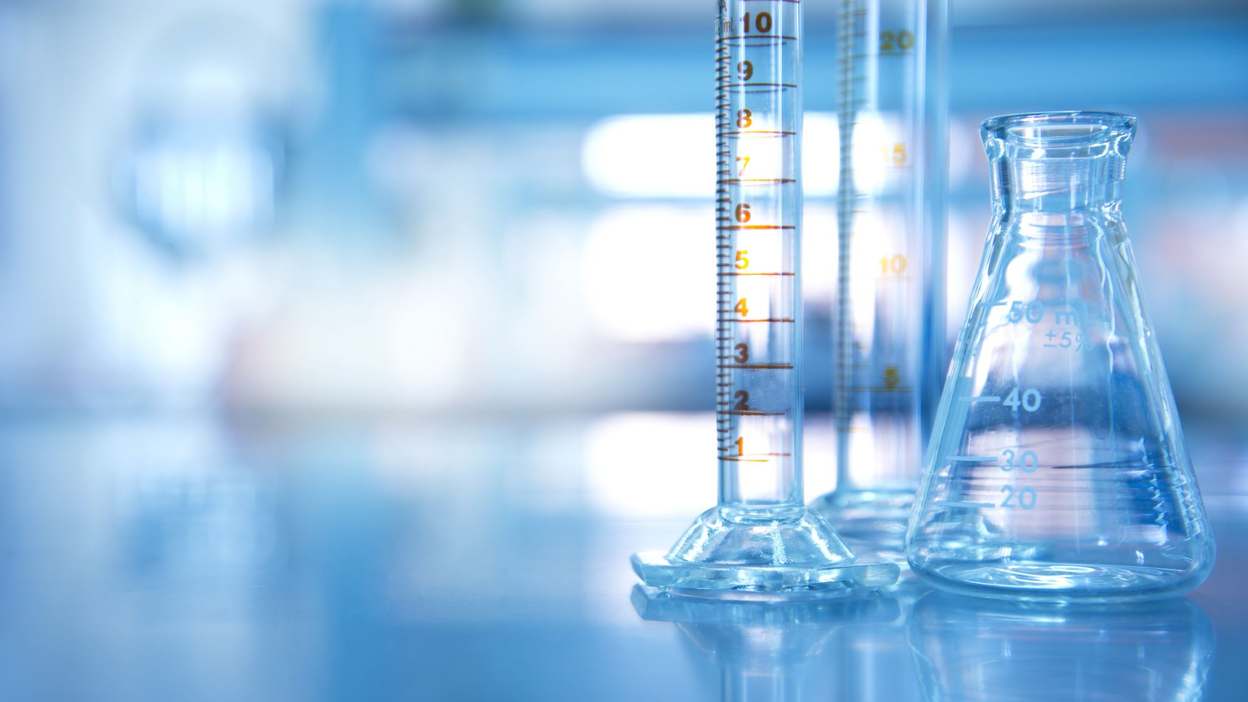
Abstract:
Arsenic is a harmful chemical found in groundwater.
Many people in Bangladesh are affected by arsenic poisoning.
Long exposure causes visible skin problems like dark patches, thick skin, and sores.
Early detection can save lives and prevent serious illness.
Doctors in rural areas are not always available.
Machine learning can help detect these skin problems automatically from pictures.

Slide 3
The Problem:
Arsenic contamination affects millions of people.
Manual detection needs doctors and lab tests.
Rural people often cannot reach hospitals.
Many cases remain undiagnosed until late stages.
We need an automated, low-cost tool to help health workers detect arsenic skin disease easily.

Slide 4
Project Goals (Objectives)
Create
Create a dataset of skin images (healthy and arsenic-affected).
Preprocess
Preprocess images — clean, resize, and standardize.
Extract
Extract useful features like texture, color, and shape.
Train
Train ML models (SVM, Random Forest, CNN).
Compare
Compare results and find the best-performing model.
Build
Build a simple app or website for skin testing.
Help
Help rural doctors detect arsenic problems faster.

Slide 5
What Others Have Done (Literature Review)
CNN models are good at recognizing skin diseases like melanoma or eczema (Paul et al., 2020).
Some researchers used texture-based models like SVM and got good accuracy too (Rahman et al., 2022).
WHO reports show arsenic poisoning is still a major issue.
But no one has created a machine learning system for arsenic skin disease detection yet.
Our project fills this research gap.

Slide 6
How the System Works (Methodology Overview)
Data Collection: Gather skin images from datasets or medical sources.
Preprocessing: Resize, remove noise, normalize lighting.
Feature Extraction: Identify key patterns (color, texture, shapes).
Model Training: Train different algorithms (SVM, RF, CNN).
Testing and Evaluation: Measure accuracy, precision, recall, and F1-score.
Deployment: Build a simple graphical interface (GUI or web app).
Input Image → Preprocessing → Feature Extraction → ML Model → Output (Normal / Affected)

Slide 7
Tools and Technologies
Programming Language: Python
Libraries: TensorFlow, Keras, Scikit-learn, OpenCV
Framework: Flask or Tkinter (for interface)
Dataset: Medical and online arsenic skin image data
Evaluation Metrics: Accuracy, Precision, Recall, F1-score

Slide 8
Expected Results
A working machine learning model that detects arsenic skin lesions.
Accuracy above 85% for classification.
A labeled dataset for future use.
A demo application for testing.
A full report and GitHub repository with all project files.

Slide 9
Advantages of the System
Fast and low-cost diagnosis support.
Easy to use by health workers in rural areas.
Can reduce workload of dermatologists.
Early detection can save lives.
Can be expanded for other skin diseases later.

Slide 10
Future Work
Collect more real-life images to improve accuracy.
Add mobile app support for on-site testing.
Collaborate with hospitals for field validation.
Use deep learning (CNN + Transfer Learning) for better performance

Slide 11
Challenges
Hard to collect a large, labeled dataset.
Lighting and image quality can affect accuracy.
Need medical experts for correct labeling.
Privacy and ethical issues for patient photos

Slide 12
Conclusion
Arsenic contamination is a serious health issue in Bangladesh.
Our ML-based system can help detect skin problems early.
It supports healthcare in remote areas.
This project combines technology and medicine to save lives.
Future improvements can make it more accurate and accessible.

